Slide 1

NC Census Employment Data analysis
EJ, Bill, Abby, Teshanee, Niral

Slide 2
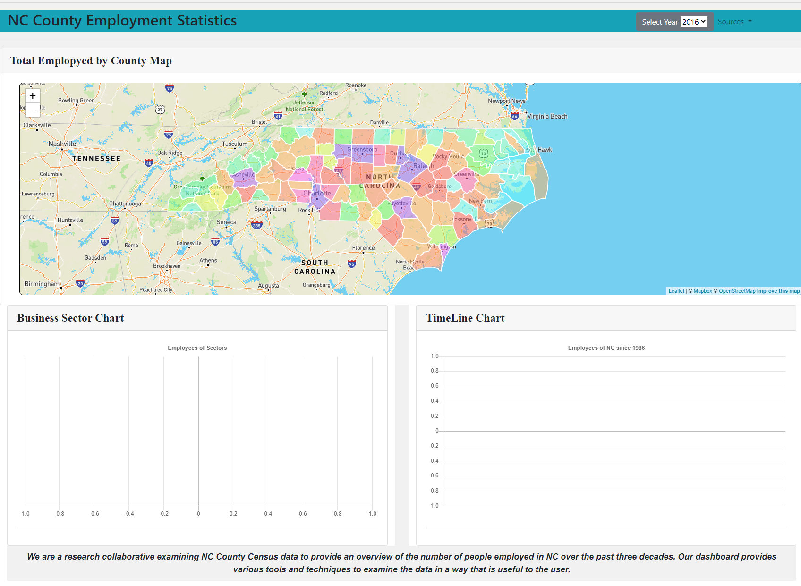
Product Introduction
Show the working site
Explain all features on the site
Data visualization information

Slide 3
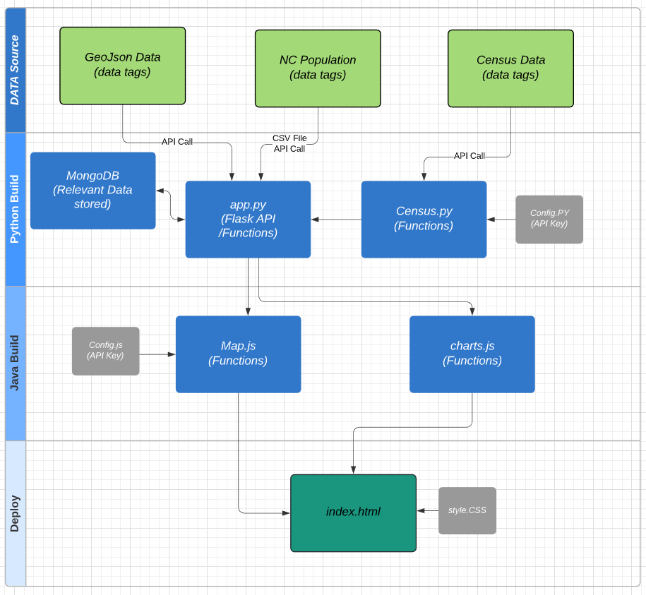
High Level Data Flow
List of
Leaflet
Flasks
MongoDB
Chart.js
Mapbox
D3
Json
bootstarp
Notes:
Three main phase
Data sources
Build (Python, Java & HTML)
Deploy

Slide 4
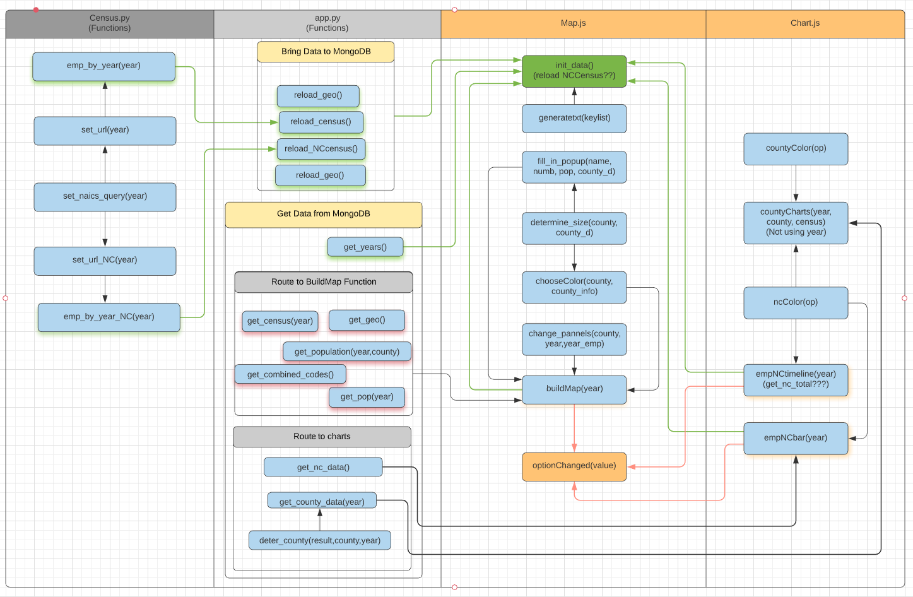
Function Flow Diagram

Slide 5
Data Collection

Slide 6
Summary
Notes:
Purpose of building this page
Speak to the dashboard in the summary
Explain some of the observation over various year data

Slide 7
Question?

Slide 8
Backup Slides

